Slide 1
Chronic Kidney DISEASE Screening Case
By Hoang Nha Nguyen
By Nha Nguyen

Slide 2

Agenda
Case Objective
Data Exploration
Imputation - “Mice” Package
Backward vs Forward Selection Technique

Slide 3
Case Objective
To build a predictive model that could be turned into a quick screening tool that identifies patients who are at higher risk of developing CKD.
Two main causes of CKD are diabetes and high blood pressure/ hypertension.
Heart disease is major cause of death for people with CKD.

Slide 4

Data Exploration
The data set consists of selected information from 8,819 adults 20 years of age or older taken from the 1999 to 2000 and 2001 to 2002 surveys.
The dataset is divided into 2 sets:
6,000-case training set
2,819-case hold-out sample for testing. -> CKD has to be predicted
A test for CKD was given to everyone in the study population.
Target Variable is CKD, a binary variable indicating whether or not the subject had CKD.
The 33 independent variables include age, weight, income, cholesterol level, systolic/diastolic blood pressure, family history of diabetes, cardiovascular diseases, etc.
Notes:
The sample subjects were randomly divided into two pools

Slide 5
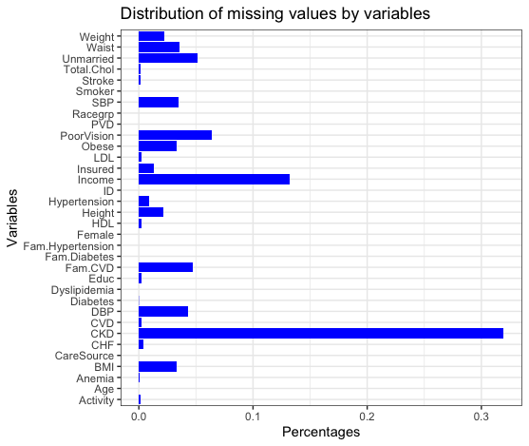
Missing Values
Our dataset consists of 8819 responses against 33 attributes (8819 x 33) 291027 individual responses are to be recorded.
Only 283285 are recorded and 7742 records are missing (which is about 2.6 % of the data set)
Issue: Class Imbalance problem -> Only 464 out of 6000 have CKD
There are 24 variables with missing values.

Slide 6
Imputation
Use MICE package with Predictive Mean Matching method to fill in the missing data.
Combine multiple implication methods to predict missing values based on known values
Skip variables with no missing values -> predictors
Specify imputation methods for each variable:
‘logreg’ - logistic regression imputation (binary data, factor with 2 levels)
‘polyreg’ - polytomous regression imputation for unordered categorical data (factor > 2 levels)
‘norm’ - continuous variables

Slide 7
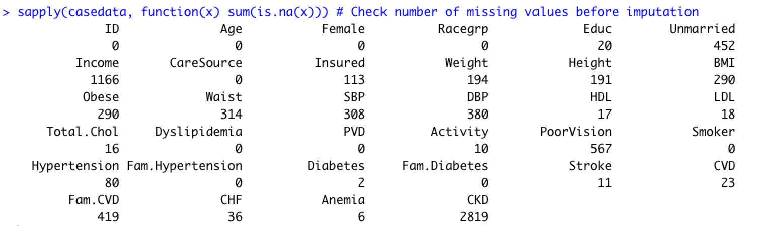
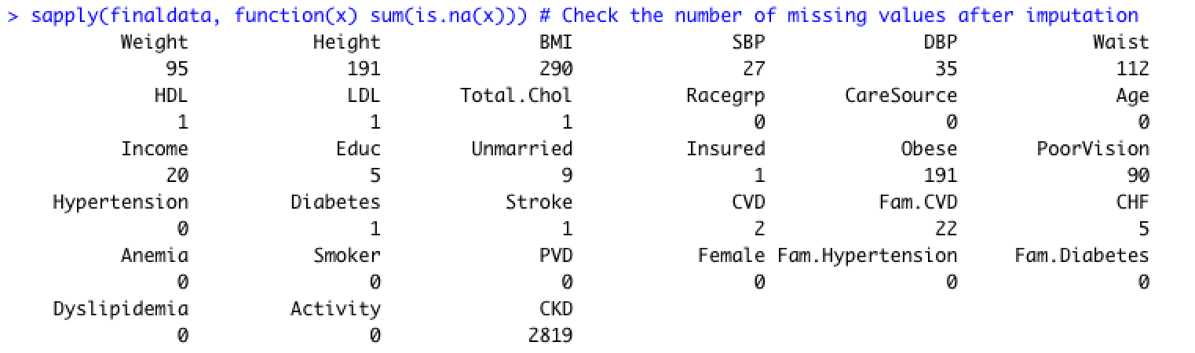
Before Imputation
After Imputation

Slide 8
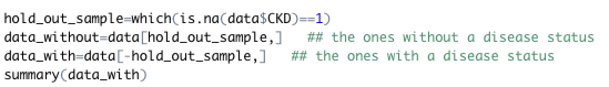
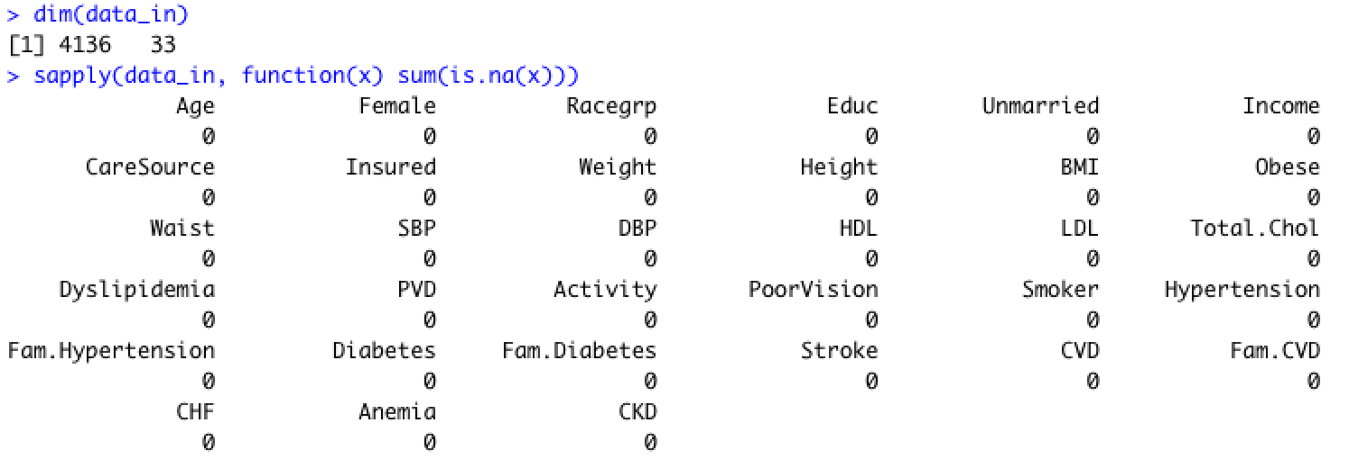
Divide datasets

Slide 9
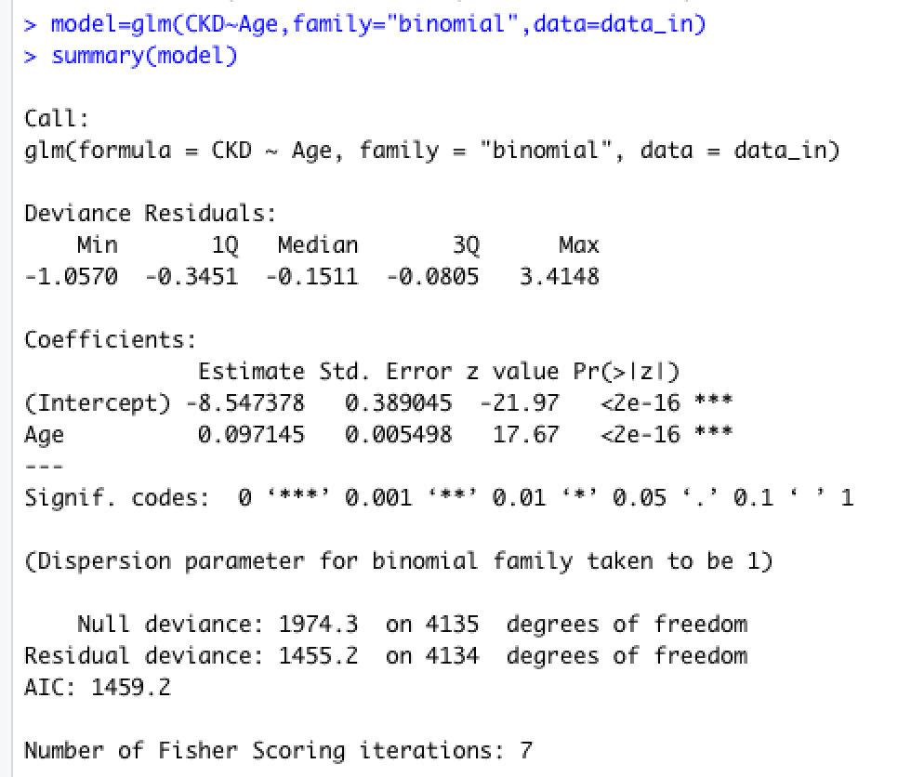
LRM (CKD ~ AGE)
The coefficient of age is positive indicating that an increase in age will lead to an increase in the probability of someone having CKD

Slide 10
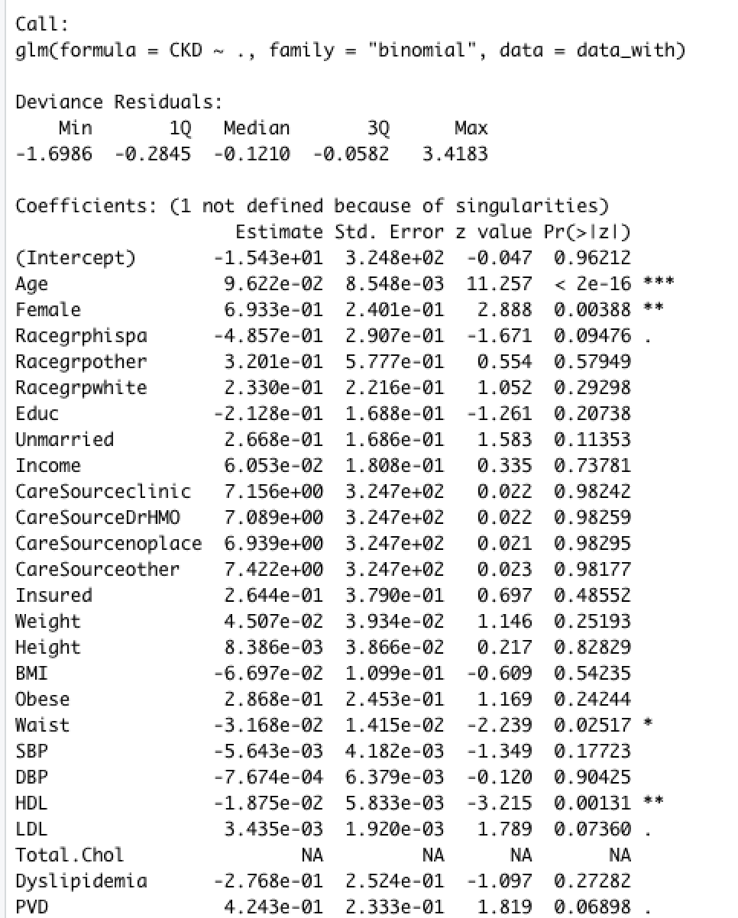
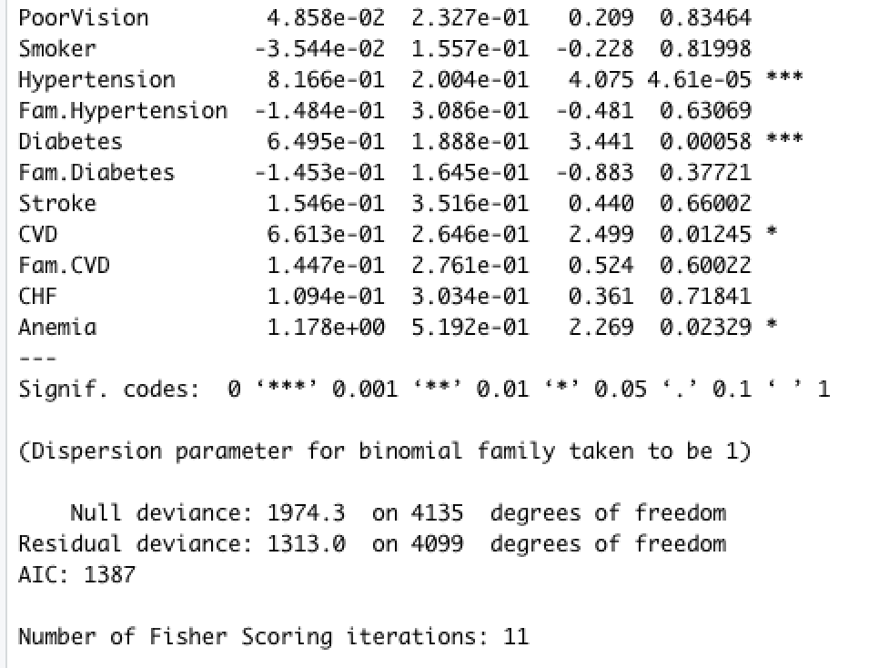
Base Model

Slide 11
Backward v.s Forward Selection
Forward selection, which starts with no predictors in the model, iteratively adds the most contributive predictors, and stops when the improvement is no longer statistically significant.
Backward selection , which starts with all predictors in the model (full model), iteratively removes the least contributive predictors, and stops when you have a model where all predictors are statistically significant.

Slide 12

Evaluation Metrics
Deviance is a measure of goodness of fit of a model. Higher numbers always indicate bad fit. The null deviance shows how well the dependent variable is predicted by a model that includes only the intercept (grand mean), while residual includes independent variables.
AIC (Akaike Information Criterion) and P-value
AIC - estimation of prediction error -> lower means better

Slide 13
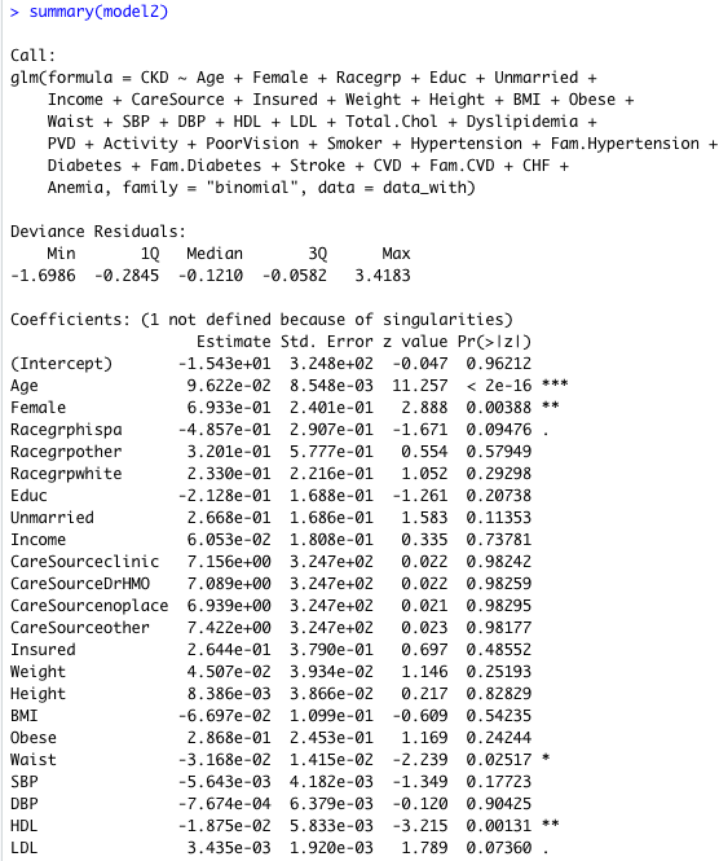
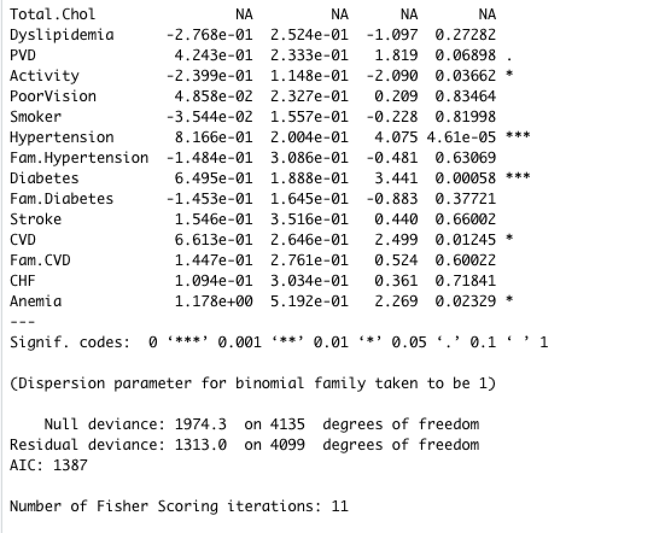
Model 2 - Forward Selection

Slide 14
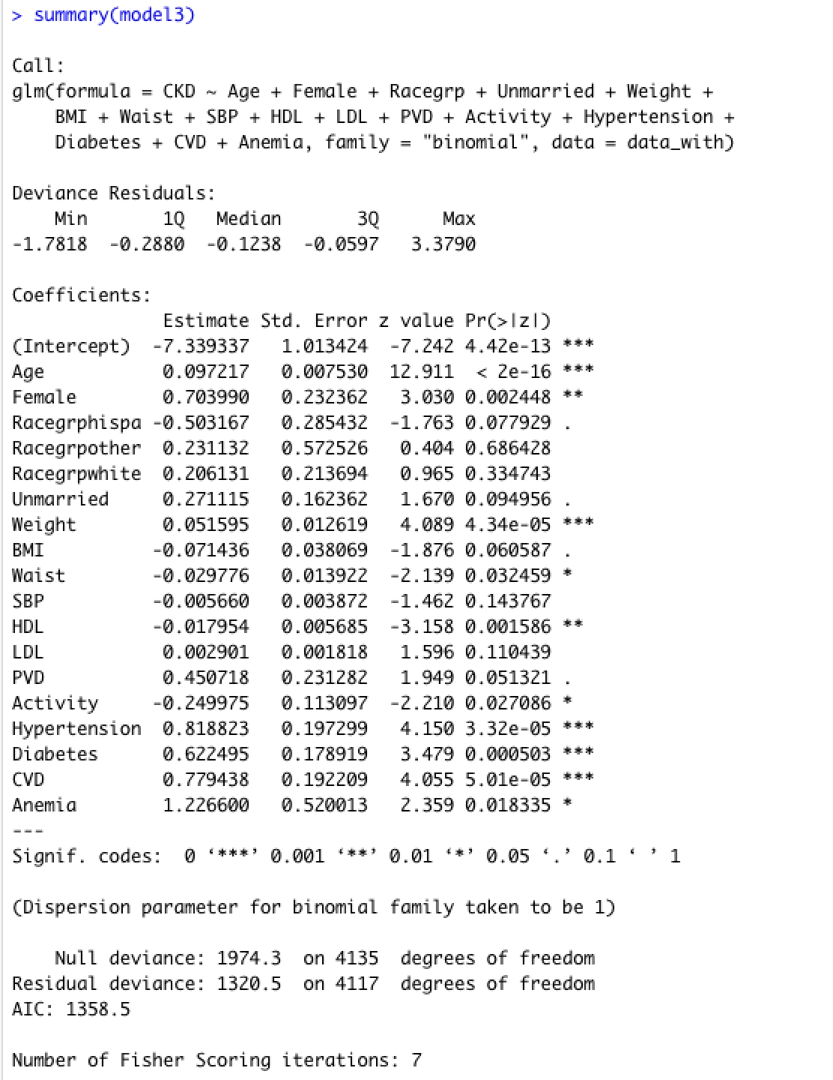
Model 3 - Backward Elimination

Slide 15
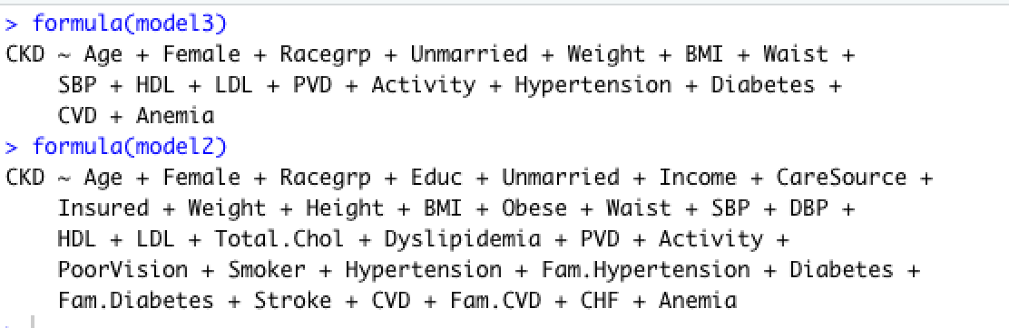
Model Comparison
Interpret: The final result above gives us the most important variables. Model 3 has the lower AIC (1358.5) and hence the best model.

Slide 16
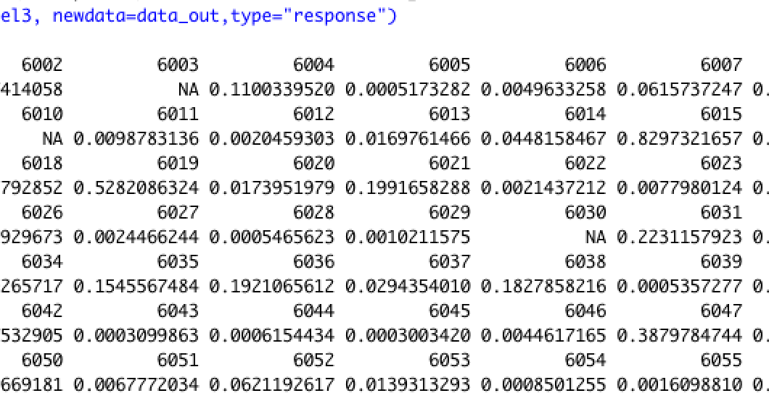
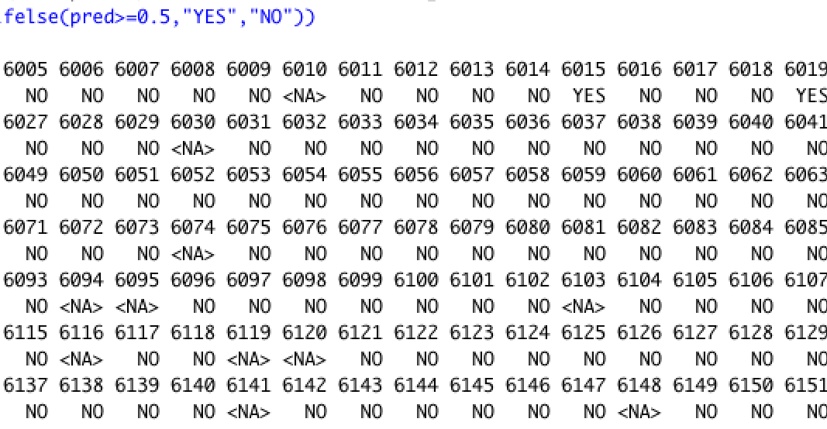
Prediction on test sample

